Slide 1
A PowerPoint Presentation on “VIRTUAL REALITY”
Done by:
Name - Vinay S

Slide 2
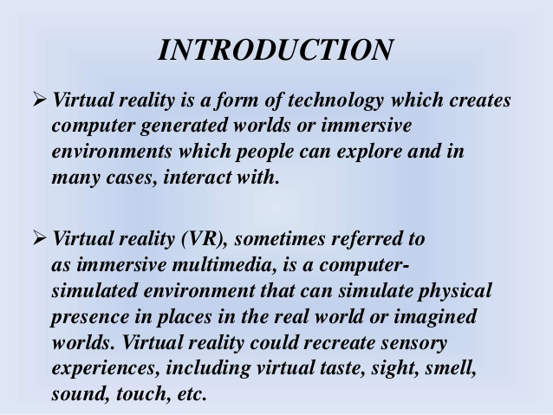

Slide 3
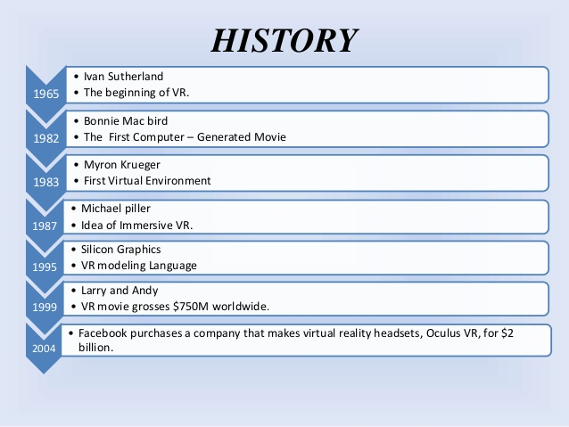

Slide 4
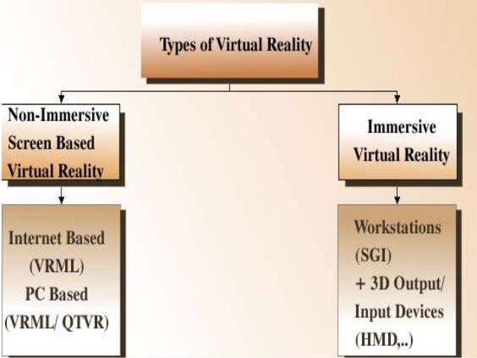

Slide 5
Implementation of VR
For developing virtual reality games, one must have thorough knowledge about the following programming languages – C++,Java, Python and Pearl.
Few of the popular Virtual Reality games in the last couple of years are
Omega Agent
Wind lands
The Vanishing of Ethan Carter
ADR1FT

Slide 6
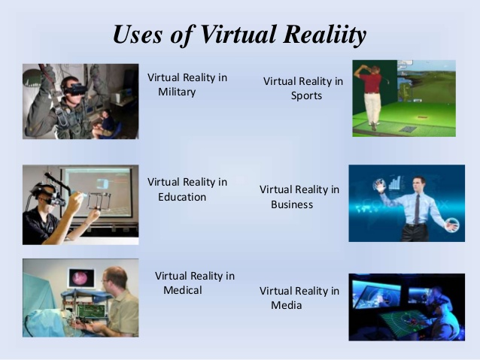

Slide 7
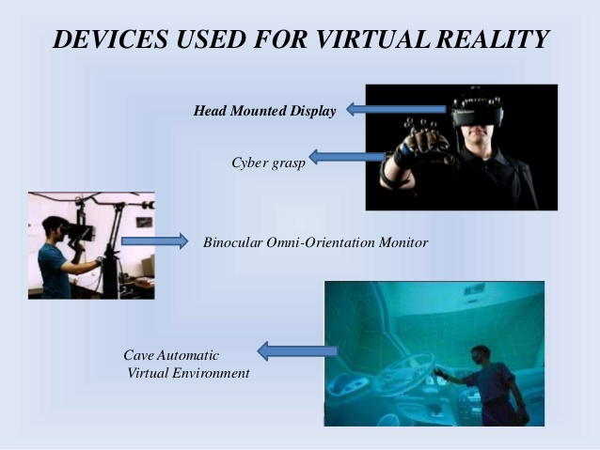

Slide 8
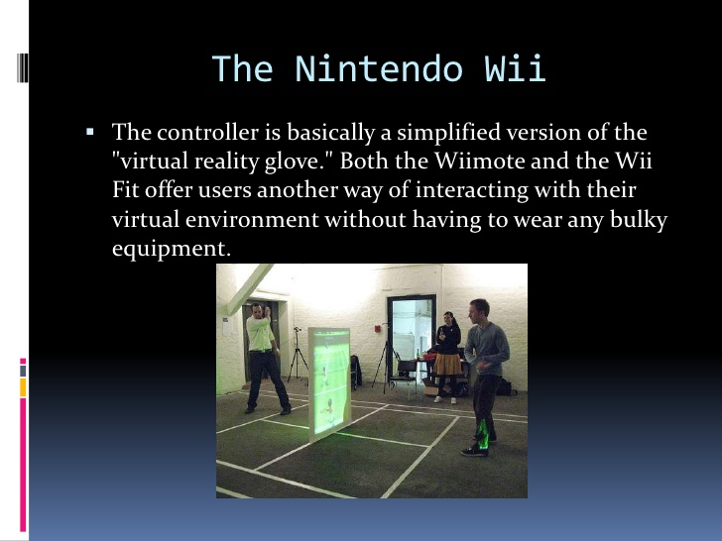

Slide 9
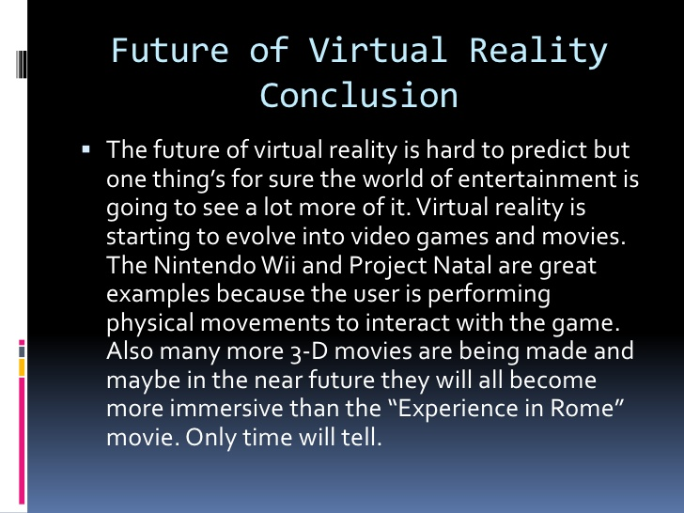

Slide 10


